Slide 1
NEURAL NETWORKS, BACKPROPAGATION,
AND PATTERN RECOGNITION
Bryan Greener
Design & Analysis of Algorithms Spring 2018

Slide 2
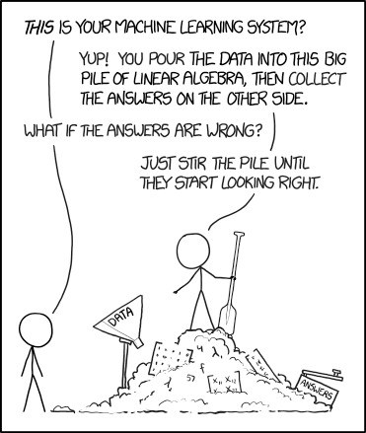
WHY DO WE NEED THEM?
Pattern Recognition
Processing Speed
Solving Complex Algorithms
Memory Footprint
Developing Artificial Intelligence
Design & Analysis of Algorithms Spring 2018

Slide 3
WHERE ARE THEY USED?
Traffic Lights
Self-Driving Cars
Facial Recognition
Automated Data Input
Stock Market Prediction
NP Hard Algorithms
Medical Diagnostics
Loan Approvals
Video Games
…and so much more!
Design & Analysis of Algorithms Spring 2018

Slide 4
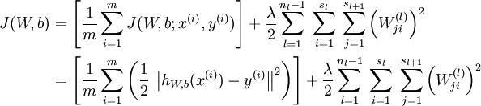
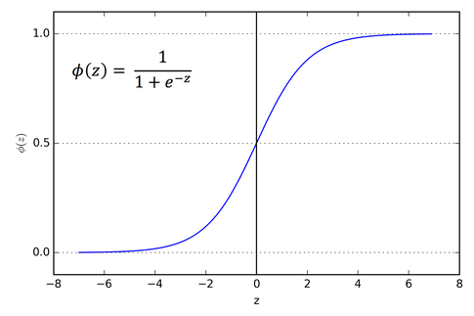
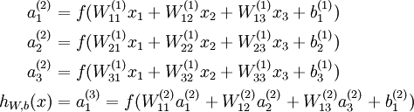
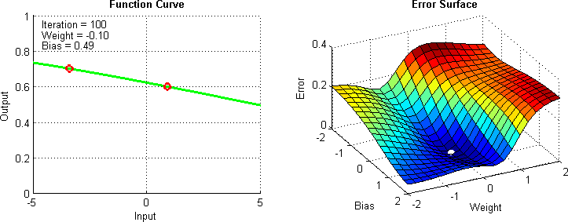
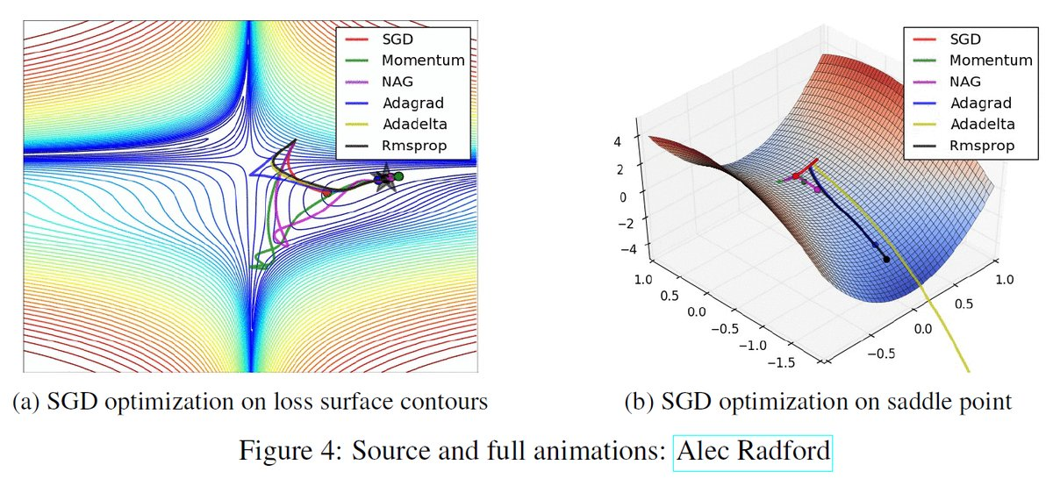
HOW DO THEY WORK?
Lots of linear algebra…
Design & Analysis of Algorithms Spring 2018

Slide 5
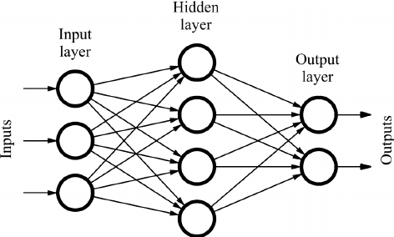
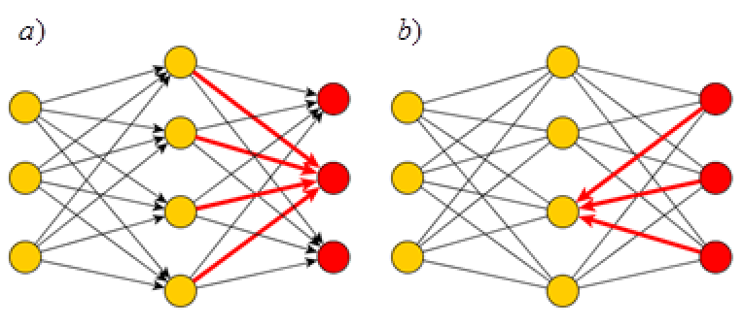
HOW DO THEY WORK?
Initialize matrices
Feed Forward
Calculate error at output layer
Backpropagate error
Update weights with gradient of cost function
Design & Analysis of Algorithms Spring 2018

Slide 6
Original Program
Gradient Descent Algorithm:
Stochastic Gradient Descent
(SGD)
Design & Analysis of Algorithms Spring 2018

Slide 7
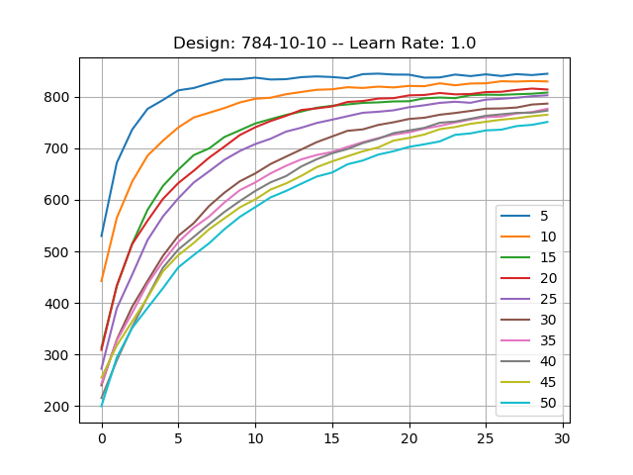
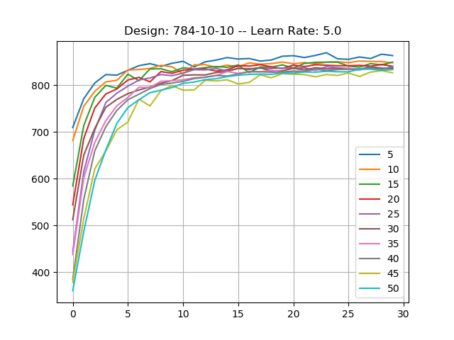
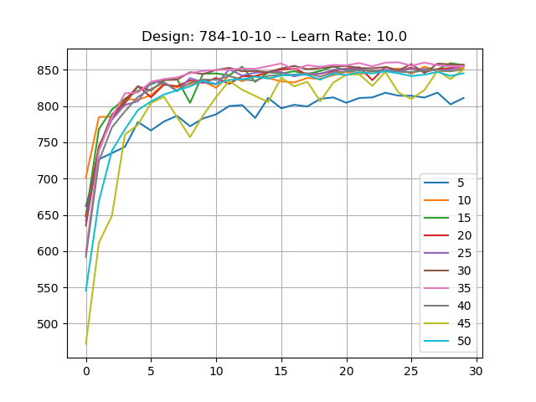
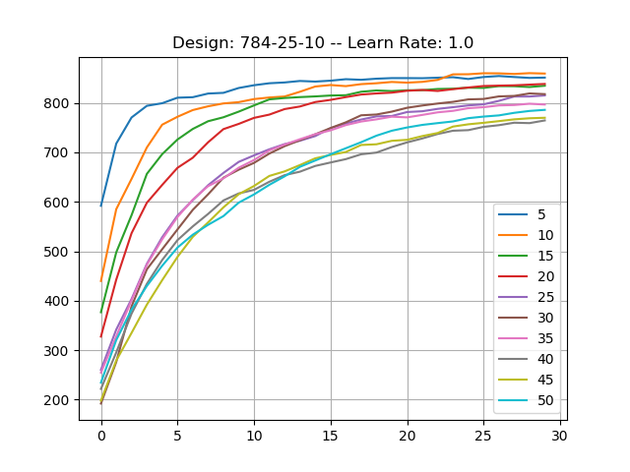
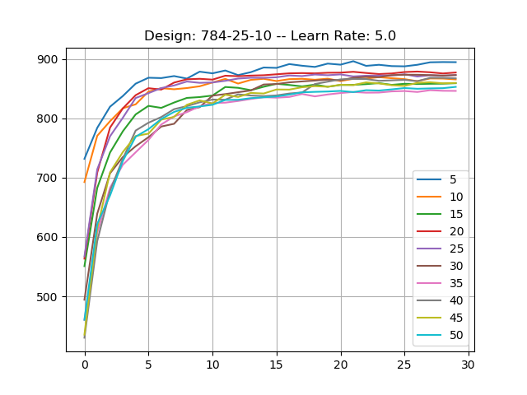
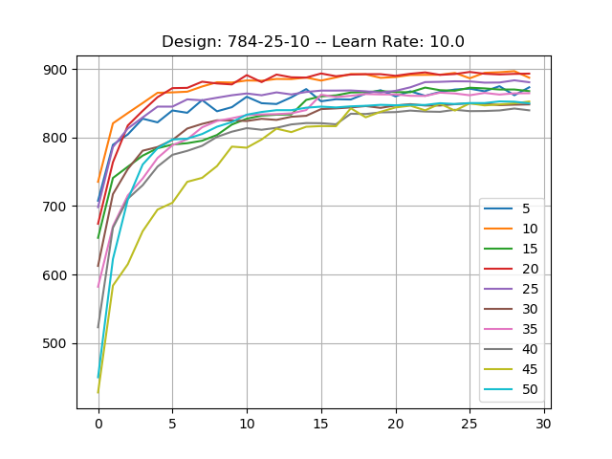
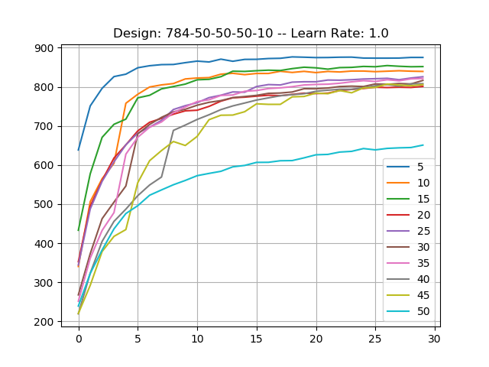
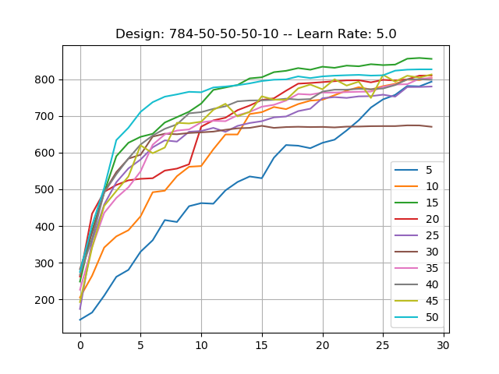
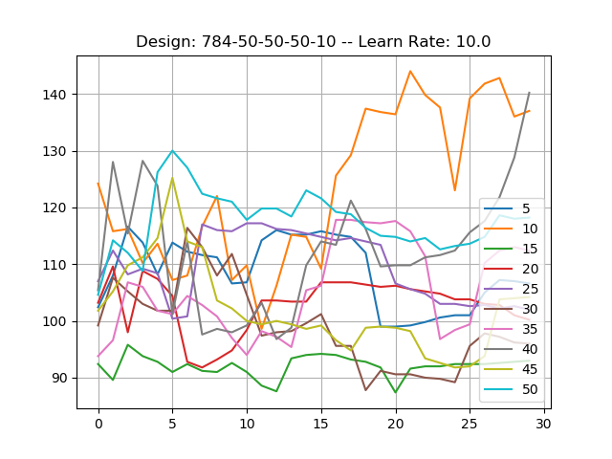
RESULTS:
Accuracy
Design & Analysis of Algorithms Spring 2018

Slide 8
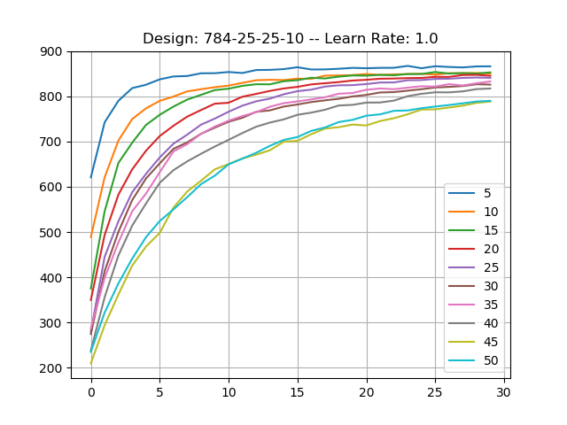
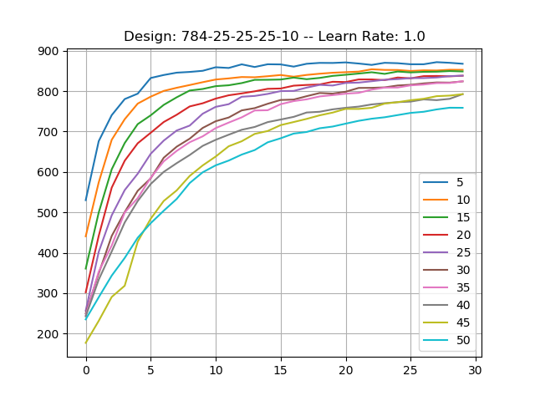
RESULTS:
Accuracy
Design & Analysis of Algorithms Spring 2018

Slide 9
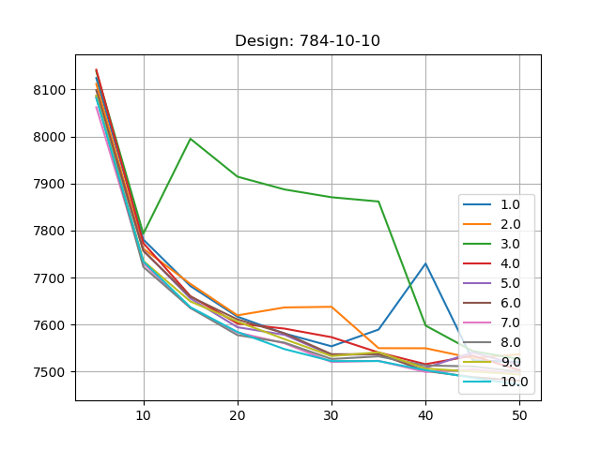
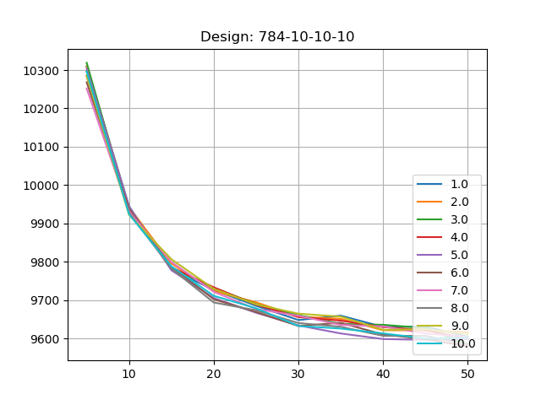
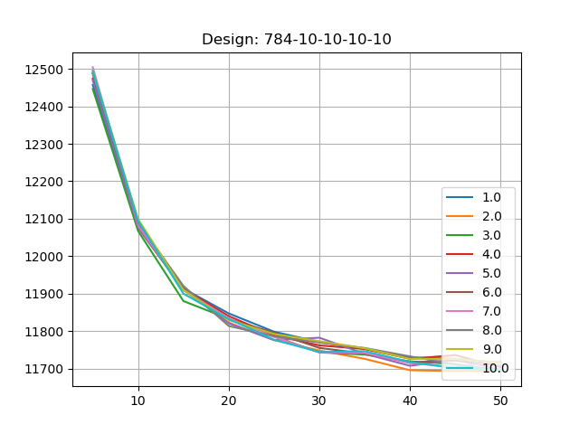
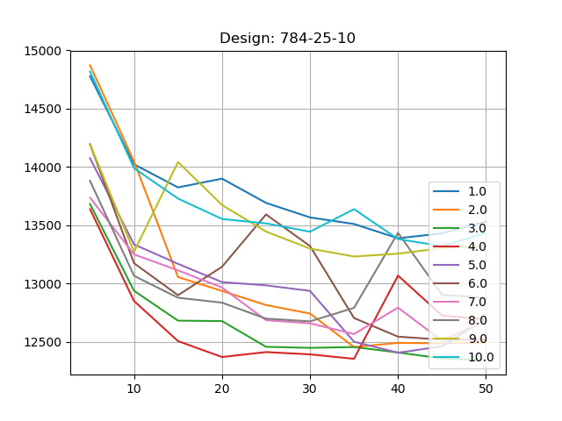
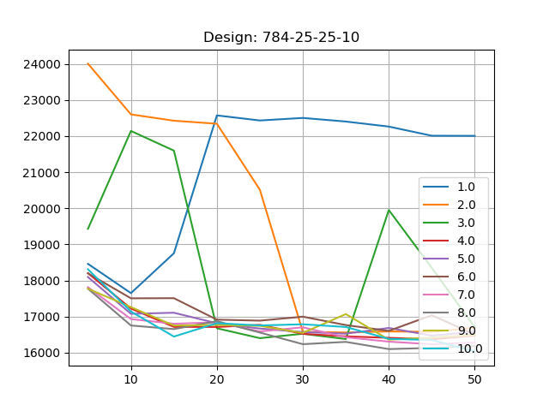
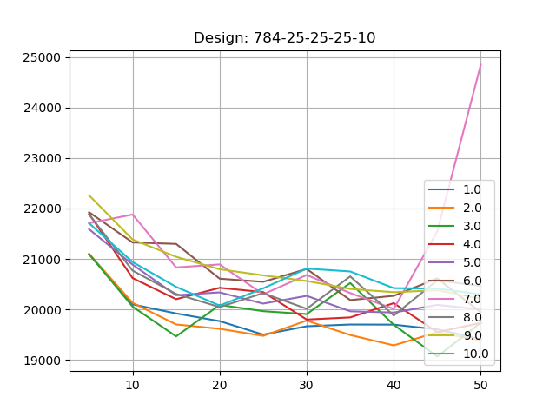
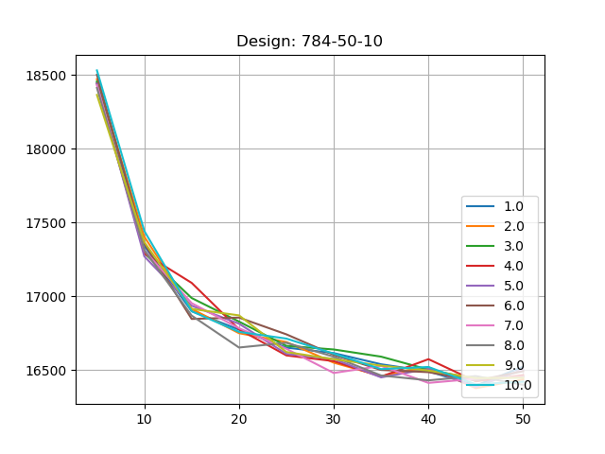
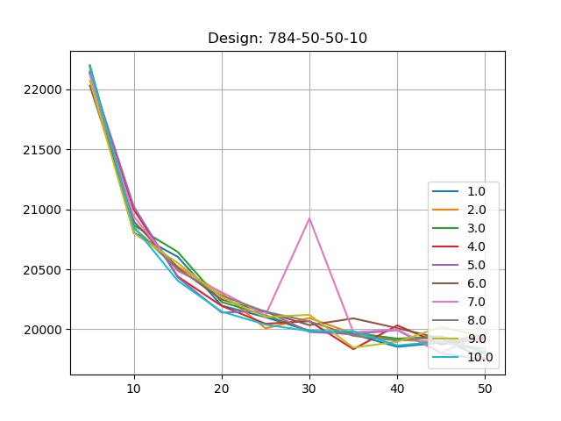
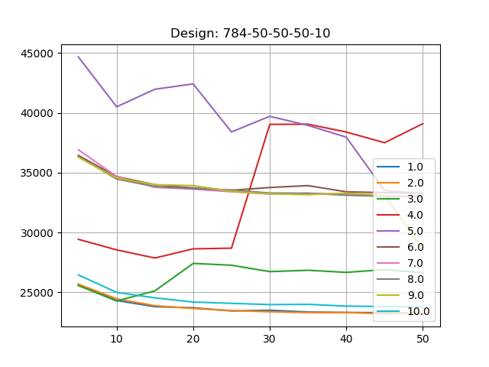
RESULTS:
Time
Design & Analysis of Algorithms Spring 2018

Slide 10
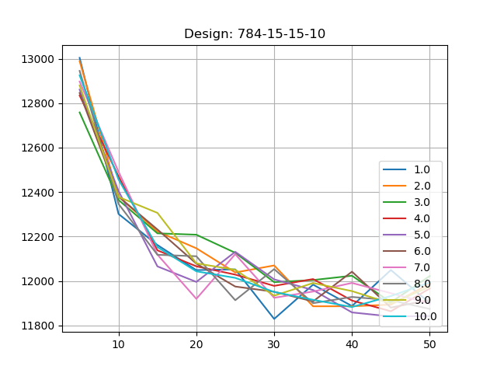
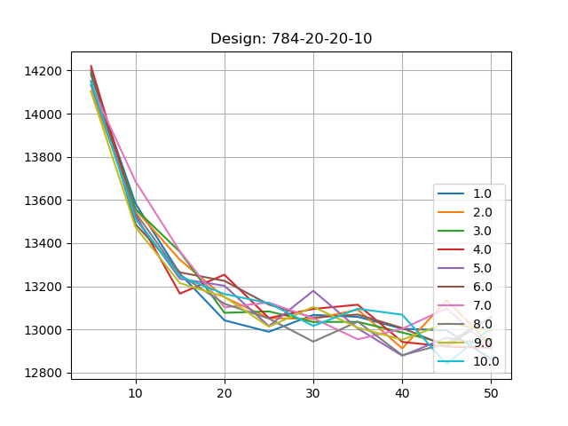
RESULTS:
Time
Design & Analysis of Algorithms Spring 2018

Slide 11
Optimized Program
Gradient Descent Algorithm:
RMSprop w/ Nesterov Momentum
Design & Analysis of Algorithms Spring 2018

Slide 12
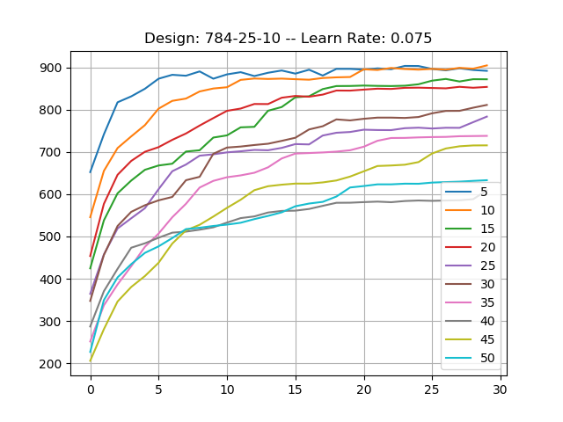
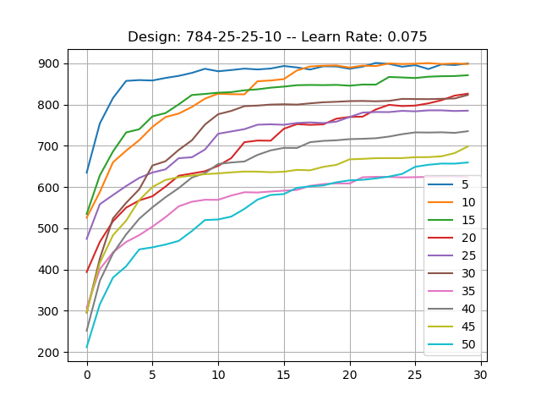
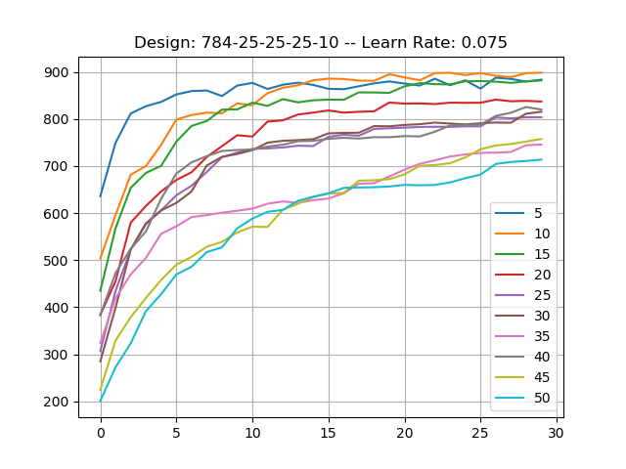
RESULTS:
Accuracy
Design & Analysis of Algorithms Spring 2018

Slide 13
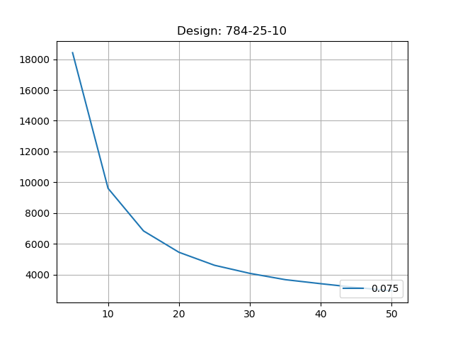
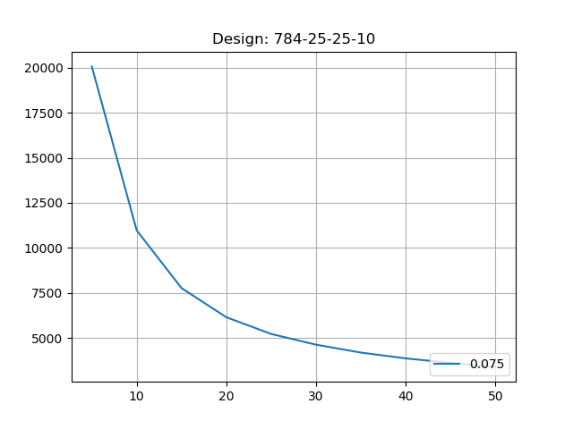
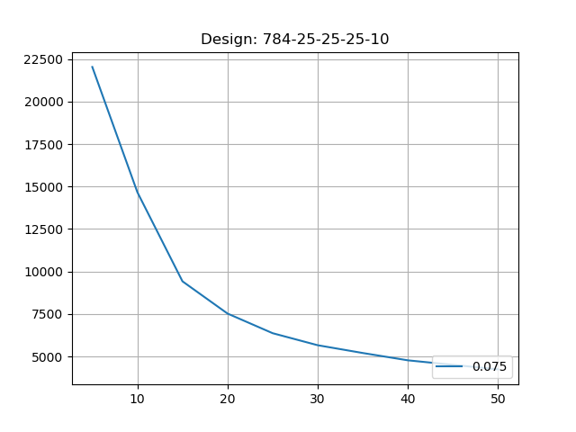
RESULTS:
Time
Design & Analysis of Algorithms Spring 2018

Slide 14
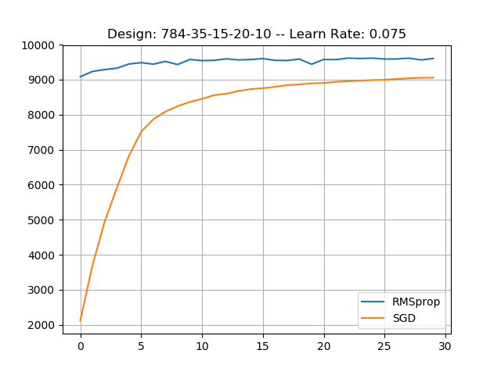
RMS vs SGD
Accuracy over 30 epochs
Time for 30 epochs
SGD | RMS
141.2 Seconds | 288.9 Seconds
Design & Analysis of Algorithms Spring 2018

Slide 15
Sources:
Neural Network Basics
http://neuralnetworksanddeeplearning.com
https://github.com/stephencwelch/Neural-Networks-Demystified
https://wiseodd.github.io
Backpropagation
https://mattmazur.com/2015/03/17/a-step-by-step-backpropagation-example/
Jahangir, Mostafa, et al. “Design of a Fast Convergent Backpropagation Algorithm Based on Optimal Control Theory.” Nonlinear Dynamics, vol. 70, no. 2, 2012, pp. 1051–1059., doi:10.1007/s11071-012-0512-1.
International Journal of Soft Computing and Engineering (IJSCE)
ISSN: 2231-2307, Volume-1, Issue-1, March 2011
Hashem, Tahsina, et al. “Handwritten Bangla Digit Recognition Employing Hybrid Neural Network Approach.” 16th Int'l Conf. Computer and Information Technology, 2014, doi:10.1109/iccitechn.2014.6997353.
Lecun, Yann A., et al. “Efficient BackProp.” Lecture Notes in Computer Science Neural Networks: Tricks of the Trade, 2012, pp. 9–48., doi:10.1007/978-3-642-35289-8_3
Optimization
http://ruder.io/optimizing-gradient-descent/
https://towardsdatascience.com/stochastic-gradient-descent-with-momentum-a84097641a5d
http://climin.readthedocs.io/en/latest/rmsprop.html
http://ruder.io/optimizing-gradient-descent/index.html#nesterovacceleratedgradient
Design & Analysis of Algorithms Spring 2018

